Slide 1
Office 365 development

Slide 2
Deep dive into the Office 365 Microsoft Graph API
</>

Slide 3
Developer vision

Slide 4
Agenda
Why the need for Microsoft Graph API
What is the Microsoft Graph API
Supported areas
Roadmap

Slide 5
1
Why the need for the Microsoft Graph API?

Slide 6












Data silos in the enterprise
USER
FILES
EMAIL AND CONVERSATIONS
EVENTS
PEOPLE
GROUPS

Slide 7
Directory
USER
PEOPLE
GROUPS
Azure Active Directory Graph API
https://graph.windows.net/contoso.com/users
https://graph.windows.net/contoso.com/groups

Slide 8
Extended Profile
USER
PEOPLE
GROUPS
SharePoint User Profile
https://contoso.sharepoint.com/_api/SP.UserProfiles.PeopleManager/GetMyProperties
Exchange HD Picture
https://graph.microsoft.com/v1.0/me/photo

Slide 9
Mail, Calendar, and Conversations
USER
EMAIL AND CONVERSATIONS
EVENTS
GROUPS
Exchange REST API
https://outlook.office365.com/api/v1.0/me/Messages
https://outlook.office365.com/api/v1.0/me/Events

Slide 10
Files
USER
FILES
PEOPLE
GROUPS
OneDrive for Business/SharePoint Files API
https://contoso-my.sharepoint.com/personal/yina_contoso_com/_api/v1.0/files
https://contoso.sharepoint.com/sites/designCouncil/_api/v1.0/files

Slide 11
Office Graph
USER
FILES
PEOPLE
Office Graph in SharePoint Online
https://contoso.sharepoint.com/_api/search/query?Querytext='*'&Properties='GraphQuery:actor(ME,action\:1020,or(action\:1020\,action\:1003,action\:1001,action\:1024,action\:1005,action\:1037,action\:1039,action\:1036)'&SelectProperties='Docid,Title

Slide 12
2
What is the Microsoft Graph API?

Slide 13
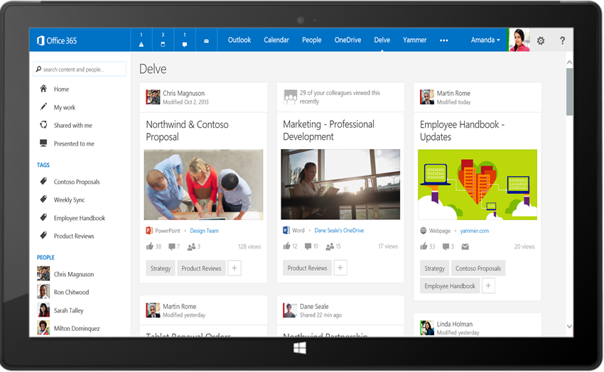
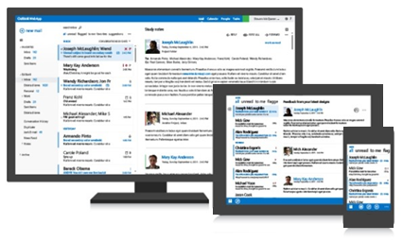
Office 365 Microsoft Graph API
Your Add-in
https://graph.microsoft.com/
USERS
GROUPS
FILES
MAIL
CALENDAR
TASKS
Insights and relationships from Office Graph

Slide 14
Breaking silos
USER
FILES
EMAIL AND CONVERSATIONS
EVENTS
PEOPLE
GROUPS

Slide 15
Single well-known endpoint
Single well-known resource
Only one OAuth access token needed
Navigate across workloads and relationships logically
Benefits to Microsoft Graph API

Slide 16
Functionality will likely show up first in service-specific endpoints
Desire to have all service-specific functionality in Microsoft Graph API
Service-specific APIs will continue to require resource-specific access tokens
Microsoft Graph API versus Service APIs

Slide 17
/me
USER
USER
userPhoto
thumbnailPhoto
responsibilities
department
pastProjects
aboutMe
hireDate
birthday
address
mobile
jobTitle
schools
name
skills
tags
alias

Slide 18
Code
GET https://graph.microsoft.com/v1.0/contoso.com
/users/yina@contoso.com
GET https://graph.microsoft.com/v1.0/me
GET https://graph.microsoft.com/v1.0/contoso.com
/users/<id>
GET https://graph.microsoft.com/v1.0/contoso.com
/users/yina@contoso.com?$select=aboutMe
GET https://graph.microsoft.com/v1.0/me/photo

Slide 19
/messages
delay
USER
manager
directReports
memberOf
GROUPS

Slide 20
Code
GET https://graph.microsoft.com/v1.0/me/manager
GET https://graph.microsoft.com/v1.0/contoso.com
/users/yina@contoso.com/directReports
GET https://graph.microsoft.com/v1.0/me/memberOf
GET https://graph.microsoft.com/v1.0/contoso.com/users/<id>
GET https://graph.microsoft.com/v1.0/contoso.com/users/<id>/photo

Slide 21
/messages
delay
USER
manager
directReports
memberOf
GROUPS
MESSAGES

Slide 22
Code
GET https://graph.microsoft.com/v1.0/me/messages
GET https://graph.microsoft.com/v1.0/me/messages?$top=5
GET https://graph.microsoft.com/v1.0/me
/messages?$top=5&$skip=5&$orderby=DateTimeCreated
GET https://graph.microsoft.com/v1.0/me
/messages?$top=5&$select=Subject,Sender&
$search="from:alexd@contoso.com"

Slide 23
/events
delay
USER
manager
EVENTS
directReports
memberOf
GROUPS
MESSAGES
MESSAGES

Slide 24
Code
GET https://graph.microsoft.com/v1.0/me/events
GET https://graph.microsoft.com/v1.0/me/events?$top=5
GET https://graph.microsoft.com/v1.0/me
/calendarview?startdatetime=2015-04-01t01:00:00z
&enddatetime=2015-04-16t23:00:00z

Slide 25
/drive
delay
Shared with me
createdBy
USER
public
manager
directReports
EVENTS
directReports
EVENTS
modifiedBy
FILES
memberOf
GROUPS
MESSAGES

Slide 26
Code
GET https://graph.microsoft.com/v1.0/me/drive/root/children
GET https://graph.microsoft.com/v1.0/me/drive/items/<id>
GET https://graph.microsoft.com/v1.0/me
/drive/items/<id>/lastModifiedByUser
GET https://graph.microsoft.com/v1.0/mary@contoso.com/drive
/root/children
GET https://graph.microsoft.com/v1.0/mary@contoso.com
/drive/items/<id>/lastModifiedByUser/manager

Slide 27
/groups
delay
Shared with me
Shared with me
createdBy
createdBy
CONVERSATIONS
USER
public
public
manager
directReports
EVENTS
directReports
EVENTS
modifiedBy
modifiedBy
FILES
FILES
memberOf
memberOf
GROUPS
GROUPS
createdBy
MESSAGES
FILES

Slide 28
Code
GET https://graph.microsoft.com/beta/me/joinedgroups
GET https://graph.microsoft.com/v1.0/contoso.com
/groups?$filter=groupType+eq+'Unified'
GET https://graph.microsoft.com/v1.0/contoso.com/groups/<id>/members
GET https://graph.microsoft.com/v1.0/contoso.com/groups/<id>/drive/root/children
GET https://graph.microsoft.com/v1.0/contoso.com/groups/<id>/conversations
GET https://graph.microsoft.com/v1.0/contoso.com/groups/<id>/events/<id>/accept

Slide 29
/workingWith
delay
Shared with me
createdBy
CONVERSATIONS
CONVERSATIONS
USER
public
workingWith
manager
EVENTS
directReports
EVENTS
modifiedBy
FILES
memberOf
memberOf
workingWith
GROUPS
GROUPS
createdBy
createdBy
MESSAGES
FILES
FILES

Slide 30
Code
GET https://graph.microsoft.com/v1.0/me/workingWith
GET https://graph.microsoft.com/v1.0/contoso.com
/users/yina@contoso.com/workingWith
GET https://graph.microsoft.com/v1.0/contoso.com
/users/mary@contoso.com/workingWith

Slide 31
/trendingAround
delay
Shared with me
trendingAround
createdBy
CONVERSATIONS
USER
public
workingWith
workingWith
manager
directReports
EVENTS
directReports
trendingAround
modifiedBy
FILES
memberOf
workingWith
workingWith
GROUPS
createdBy
MESSAGES
FILES

Slide 32
Code
GET https://graph.microsoft.com/v1.0/me/trendingAround
GET https://graph.microsoft.com/v1.0/contoso.com
/users/yina@contoso.com/trendingAround
GET https://graph.microsoft.com/v1.0/contoso.com
/users/mary@contoso.com/trendingAround

Slide 33
API
Shared with me
trendingAround
createdBy
CONVERSATIONS
USER
public
workingWith
manager
EVENTS
directReports
trendingAround
modifiedBy
TASKS
FILES
memberOf
workingWith
TASKS
GROUPS
NOTES
createdBy
NOTES
MESSAGES
FILES

Slide 34
API
Shared with me
trendingAround
createdBy
CONVERSATIONS
USER
public
workingWith
manager
https://graph.microsoft.com/
EVENTS
directReports
trendingAround
modifiedBy
TASKS
FILES
memberOf
workingWith
TASKS
GROUPS
NOTES
createdBy
NOTES
MESSAGES
FILES

Slide 35
Graph Explorer https://graphexplorer2.azurewebsites.net
demo
Notes:
https://graph.microsoft.com/v1.0/me
https://graph.microsoft.com/v1.0/me/manager
https://graph.microsoft.com/v1.0/me/messages
https://graph.microsoft.com/v1.0/me/events
https://graph.microsoft.com/v1.0/me/drive/root/children
https://graph.microsoft.com/v1.0/me/drive/items/{id}/createdbyuser/manager
https://graph.microsoft.com/v1.0/me/drive/items/{id}/createdbyuser/manager/?$whatif
https://graph.microsoft.com/v1.0/myorganization/users
https://graph.microsoft.com/v1.0/myorganization/groups
https://graph.microsoft.com/v1.0/me/joinedgroups
https://graph.microsoft.com/v1.0/me/joinedgroups/{id}/drive/root/children
https://graph.microsoft.com/v1.0/me/joinedgroups/{id}/conversations

Slide 36
Documentation at Graph.Microsoft.io
demo

Slide 37
3
What is supported now?

Slide 38
Supported functionality
Users
Files
Mail
Calendar
Org. Contacts
Groups
Office Graph
Commercial
OAuth2.0
CORS
CRUD
OData query operations
Actions and functions
Client libraries .Net, Android, iOS

Slide 39
API
Shared with me
trendingAround
createdBy
CONVERSATIONS
USER
public
workingWith
manager
https://graph.microsoft.com/
EVENTS
directReports
trendingAround
modifiedBy
TASKS
FILES
memberOf
workingWith
TASKS
GROUPS
NOTES
createdBy
NOTES
MESSAGES
FILES

Slide 40
4
What’s coming next?

Slide 41
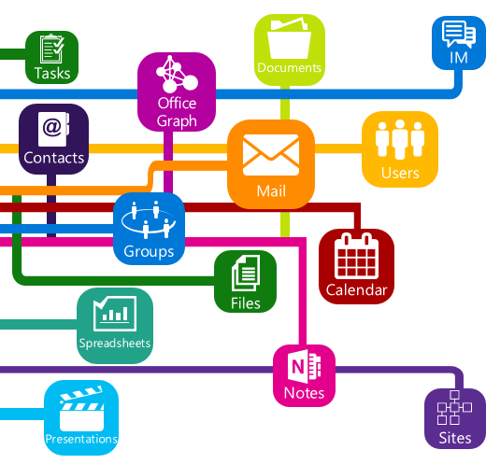
Roadmap
Notifications/web hooks
Consumer
Instant on
Personal contacts
Tasks
Notes
Skype
Additional insights and relationships
Extensibility

Slide 42
Summary
Why the need for Microsoft Graph API
What is the Microsoft Graph API
Supported areas
Roadmap

Slide 43
Further reading…
Getting started with APIs
Office 365 API code samples
Office 365 API training videos and hands on labs
Office 365 API documentation

Slide 44
Developer Program launch
1 YEAR FREE
Email Newsletters
Free Developer Subscription
Free Training
Free Tools
Webinars
http://dev.office.com/devprogram

Slide 45
Engage

